Slide 1
Data Society
Federal Regulation Textual Data Analysis
Eyong

Slide 2
To do
Objective
Analyze a public comment docket from regulations.gov to extract insights, understand public sentiment, and demonstrate advanced text analysis capabilities
Deliverables
Develop a Python script that performs a comprehensive analysis of the data. You may use either a Jupyter notebook or a standalone .py script for the implementation.
Along with the source code, include a README.md file in Markdown format which documents your solution and how to use it. Deliver the application via shared git repository (e.g. GitHub, BitBucket).
Given the above, present your findings in a concise format to business stakeholders (you can use a short summary document or a few presentation slides).
Be prepared to talk about your decision-making at a high level, for tech stack, model selection, and implementation.

Slide 3
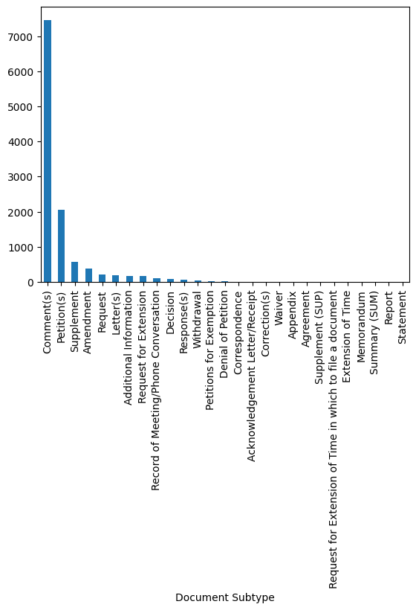
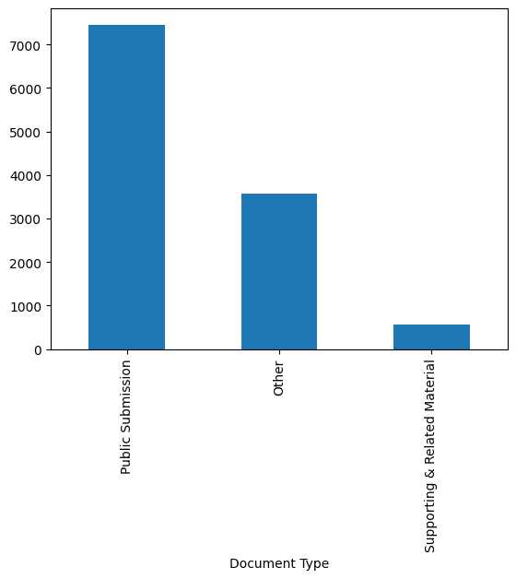
Document Types

Slide 4
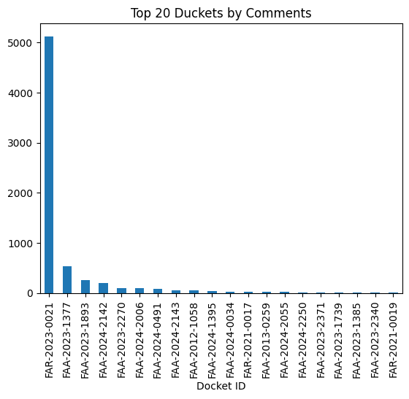
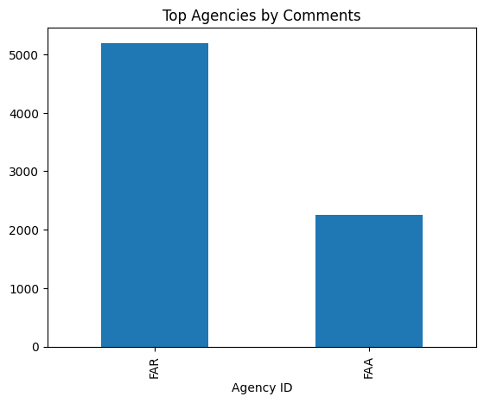
EDA

Slide 5
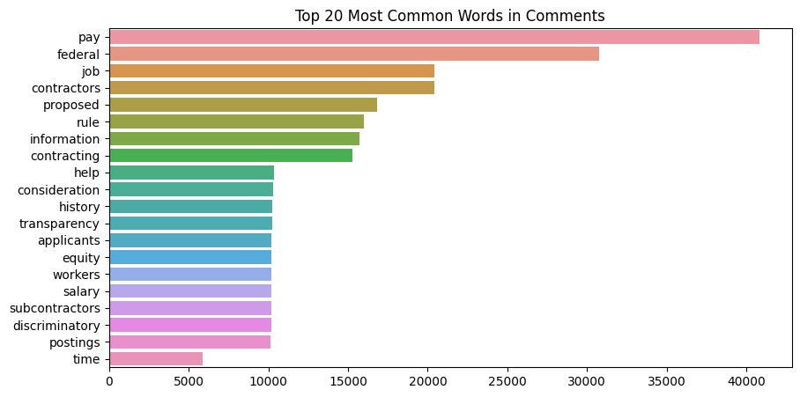
Top Words/ Terms in Overall Comments

Slide 6
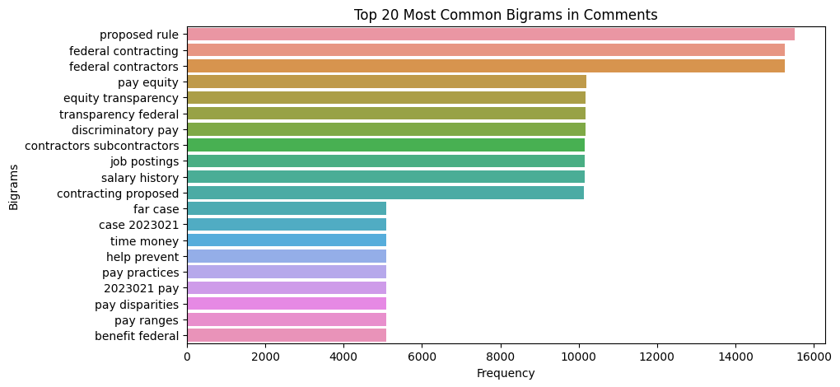
Top Words/ Terms in Overall Comments

Slide 7
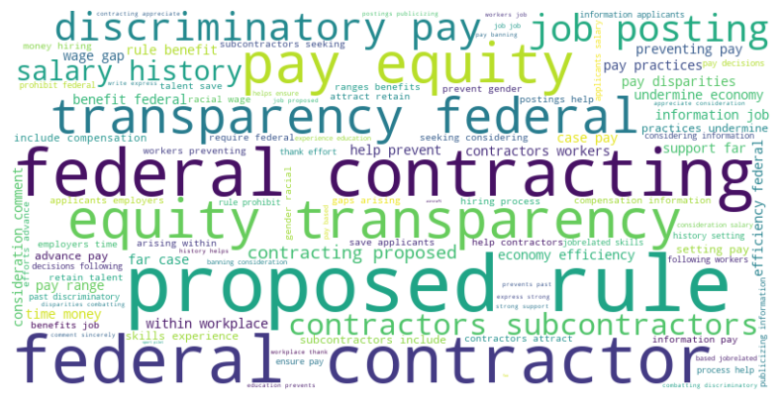
Dominant Discussion in Word Cloud
Identifying Key Topics and Concerns:
The largest words in the cloud, such as "federal contracting," "proposed rule," "pay equity," and "transparency," indicate the most common terms. These words likely represent the primary themes or focus areas in the comments.
"Discriminatory pay," "salary history," and "job posting" are also prominent, suggesting that many comments are concerned with pay practices, fairness, and equity in federal contracting.
Understanding Public Sentiment:
Terms like "discriminatory," "equity," and "transparency" reflect public interest in fairness and openness in the contracting process.
The prominence of "proposed rule" implies that there’s significant discussion or reaction to a new rule that may impact these areas.
Inferring Subtopics:
Words like "contractors," "subcontractors,“ "workers" and "employers" indicate that commenters are likely discussing specific groups impacted by the regulation.
Terms related to hiring practices, such as "job posting," "salary history," and "compensation," suggest that the regulation may include provisions addressing hiring transparency or pay equity.
Spotting Potential Concerns or Support:
Phrases like "preventing pay disparities" and "attract retain talent" may imply support for measures that promote equitable pay and talent retention.
Conversely, words like "discriminatory" could point to concerns about potential issues in the hiring process or contracting practices.
Overall Interpretation: This word cloud reveals that the public comments on the federal regulation focus heavily on equity, transparency, and non-discriminatory practices in federal contracting. The public is likely advocating for policies that prevent pay discrimination, ensure fairness, and improve the transparency of federal contracts.

Slide 8
Theme Identified
Topic #1: Employment Equity and Wage Fairness
Explanation: Centers around concerns related to employment equity, specifically within Govt procurement processes. Key issues include wage gaps, fair pay, and discrimination, especially as they pertain to women in the workforce.
Interpretation: The public is focused on ensuring fair treatment and transparency in wages, with an emphasis on eliminating discrimination in hiring and pay.
Topic #2: Federal Contracting and Transparency
Explanation: This topic highlights public concerns about transparency and fairness in federal contracting. There’s an interest in how proposed regulations will impact job equity, pay standards & contractor obligations in the federal space.
Interpretation: Stakeholders are looking for reassurance that federal contracts will be awarded in a fair, equitable, and transparent manner. There is an expectation that this regulation could set standards for fair pay and job equity.
Topic #3: Aviation Safety Regulations (Maintenance and Inspections)
Explanation: Reflects specific concerns about aviation safety related to aircraft maintenance & inspection standards. Comments mention the FAA’s role in maintaining flight safety & address proposed changes in inspection protocols.
Interpretation: The public has a vested interest in ensuring stringent maintenance and inspection standards. This topic suggests that safety issues within aviation are a top priority, with many looking to the FAA to enforce high standards.

Slide 9
Theme Identified
Topic #4: Pilot Safety and Training Standards
Explanation: The focus of this topic is on safety training standards for pilots, particularly in areas involving sport aircraft and light aircraft. It also addresses the FAA's role in establishing safety guidelines for pilot training.
Interpretation: There’s a strong demand for safety and training regulations for pilots, especially concerning lighter, sport aircraft, where additional safety measures may be required. Public opinion suggests there’s concern over pilot preparedness and the FAA's responsibility in ensuring safety in this area.
Topic #5: Space Launch Safety and FAA Oversight
Explanation: This topic covers regulations around space launches, focusing on companies like SpaceX and the safety protocols associated with spacecraft launches and related FAA oversight. There is mention of specific elements such as the rudder on spacecraft.
Interpretation: The public is interested in the FAA’s regulatory role in space exploration, particularly regarding safety protocols for commercial launches. This suggests a rising concern about the safety of space launches and the FAA's responsibilities as the regulatory authority.

Slide 10
Theme Identified - Conclusion
Public Concerns about Fairness and Transparency: Topics 1 and 2 reveal a strong public interest in issues of fairness and transparency within both employment and federal contracting processes. Stakeholders should consider whether the proposed regulations adequately address concerns about discrimination, wage gaps, and equitable contracting.
Aviation and Pilot Safety: Topics 3 and 4 reflect the public's emphasis on strict safety standards for aviation, including both aircraft maintenance and pilot training. Stakeholders in aviation may need to review the adequacy of these proposed standards to satisfy public demand for safety and FAA oversight.
Emerging Focus on Space Regulation: Topic 5 highlights growing public interest in FAA regulations on space launches, pointing to an increased awareness of and demand for regulatory oversight in this new frontier. This insight can guide policymakers in assessing the comprehensiveness of FAA regulations in space travel and exploration.

Slide 11
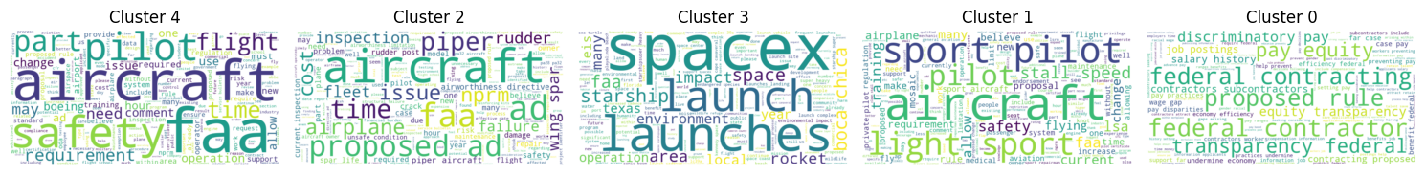
Themes – Clustering of Comments about the topic
Cluster 0: Federal Contracting and Wage Equity. This cluster reflects concerns around federal contracting processes, specifically regarding issues of transparency, fair pay, equity, and anti-discrimination measures. The public seems focused on ensuring fairness in wage practices, especially in federal contracting environments, and is concerned with how the proposed rule will address these issues.
Cluster 1: Light Aircraft and Pilot Safety Standards. This cluster is primarily focused on safety standards and regulations for light aircraft and sport pilots. The public has concerns about training requirements, safety protocols, and overall regulatory measures that ensure safe operations for this specific type of aviation.
Cluster 2: Aircraft Maintenance and Inspection Requirements. This cluster deals with issues surrounding maintenance and inspection standards in the aviation industry. Comments are focused on ensuring rigorous safety checks and FAA oversight for aircraft to maintain safety standards. This suggests a significant public interest in ensuring high maintenance standards to avoid potential failures.
Cluster 3: Space Launches and Environmental Impact. This cluster is dedicated to concerns around commercial space launches, especially those conducted by SpaceX. Key areas of focus include the environmental impact of launches, the safety of local communities, and regulatory oversight by authorities such as the FAA. Public comments emphasize the need for responsible space exploration practices.
Cluster 4: General Aviation Safety and Pilot Requirements. This cluster is broadly concerned with general aviation safety, covering topics like pilot requirements, FAA safety guidelines, and specific operational requirements for pilots and aircraft. There is a strong public interest in ensuring that pilots and operators adhere to rigorous safety standards, and in the FAA's role in regulating these standards.

Slide 12
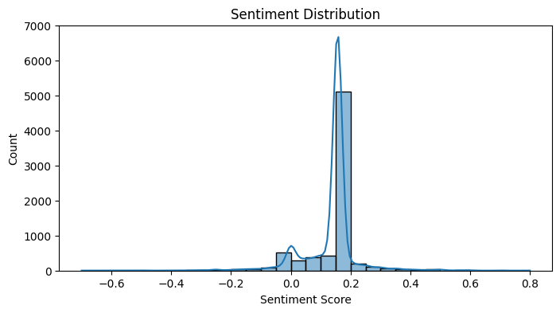
Public Opinion Analysis
As per sentiment analysis, most of the comments are negative – shows public opinion about the regulation

Slide 13
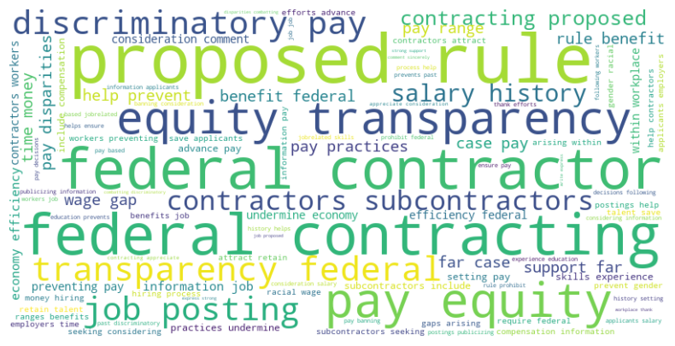
What is Positive in Comments?
Support for Transparency and Equity:
Words like "proposed rule," "equity," and "transparency" are prominent, which suggests strong support for the regulation's emphasis on fairness and open practices in federal contracting.
The terms "pay equity," "transparency federal," and "discriminatory pay" imply that commenters are positively responding to potential measures that address pay disparities and improve transparency.
Encouragement for Anti-Discriminatory Practices:
Words like "discriminatory," "pay practices," and "salary history" suggest that commenters appreciate regulatory efforts aimed at reducing discriminatory practices, such as considering an applicant's salary history in hiring processes.
The presence of "wage gap" and "pay disparities" implies that the public values regulatory interventions that might work towards closing gender or racial wage gaps.
Interest in Job Posting and Hiring Practices:
The inclusion of "job posting" and "salary history" hints that the proposed rule may address hiring transparency and job posting standards, which commenters seem to view positively.
"Help prevent" and "consideration" reflect a positive view of measures that promote fair hiring practices, possibly aimed at creating a level playing field for all applicants.

Slide 14
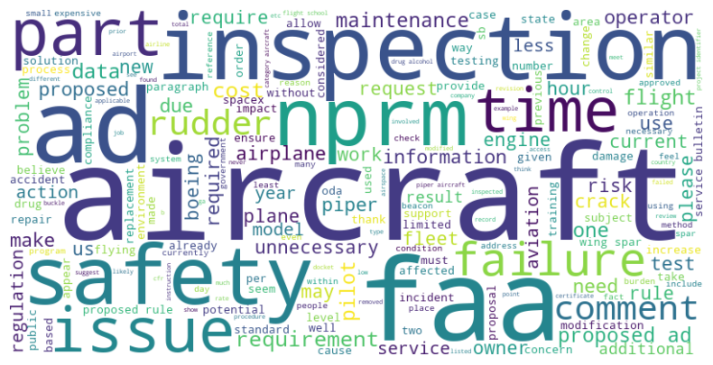
And what is Negative in Comments?
Concerns about Maintenance Standards: The word cloud suggests concerns about aircraft maintenance standards, possibly due to cost-cutting measures or inadequate inspections.
Safety Concerns: There seems to be a strong focus on safety issues, including potential failures and the need for stricter regulations.
Regulatory Burden: The word cloud indicates frustration with regulatory requirements, particularly those perceived as unnecessary or overly burdensome.
Cost-Benefit Analysis: There might be concerns about the cost of complying with regulations and the potential benefits to safety.
Overall, the word cloud reflects a negative sentiment towards the current state of aircraft maintenance and safety regulations. There are concerns about potential failures, safety risks, and the burden of regulations

Slide 15
Bot vs Human Comments
Bot or Human text detection is one of the challenging task
Although certain patterns we have observed which shows that various comments are not posted by human but from bots
Same comment multiple time or same document or on different document can be a bot
Comments on same document within small amount of time can be from a bot
Traditional methods are not effective
State of the art Large Language Models / LLMs (such as ChatGPT) can be used for this purpose

Slide 16
Incorporating LLMs
Efficiency Gains: By automating time-consuming tasks like summarization, aspect-based sentiment analysis, and keyword extraction, LLMs allow analysts to focus on higher-level interpretation and strategy. This speeds up the time-to-insight, which is particularly valuable when analyzing large comment datasets.
Improved Accuracy and Contextual Understanding: Traditional NLP methods often struggle with contextual nuances, especially in technical or regulatory language. LLMs trained on large, diverse datasets understand context and nuance better, leading to more accurate and meaningful insights.
Scalability for Large Datasets: LLMs are capable of processing large volumes of text data efficiently. This scalability is essential for high-impact federal regulation dockets that may receive thousands of comments. An LLM-enhanced pipeline can handle these volumes while maintaining high-quality analysis.
Deeper Insights with Aspect and Topic Detection: The ability to detect sentiment by specific aspects (like “cost” vs. “safety”) and to generate context-aware topics means that LLM-enhanced analysis is far more granular. Policymakers get a clear picture of public opinion on different facets of the regulation, allowing for targeted responses or modifications.
Human-Like Summarization and Explanation: LLMs provide a human-like level of summarization and explanation. Summarized content becomes more relatable and easily understandable, bridging the gap between raw data and actionable insights for decision-makers.
Enhanced Detection of Bot Influence: By using LLMs for bot detection, analysts can filter out bot-generated comments that may skew sentiment or topic analysis, resulting in more authentic and reliable insights.

Slide 17


